Slide 1
Data Bootcamp
Project #1 - Group #10 presentation
3/25/24

Slide 2
Group #10: Team Member Introductions
Chris Kilkes
Divya Govil
Ryan Hoffman

Slide 3
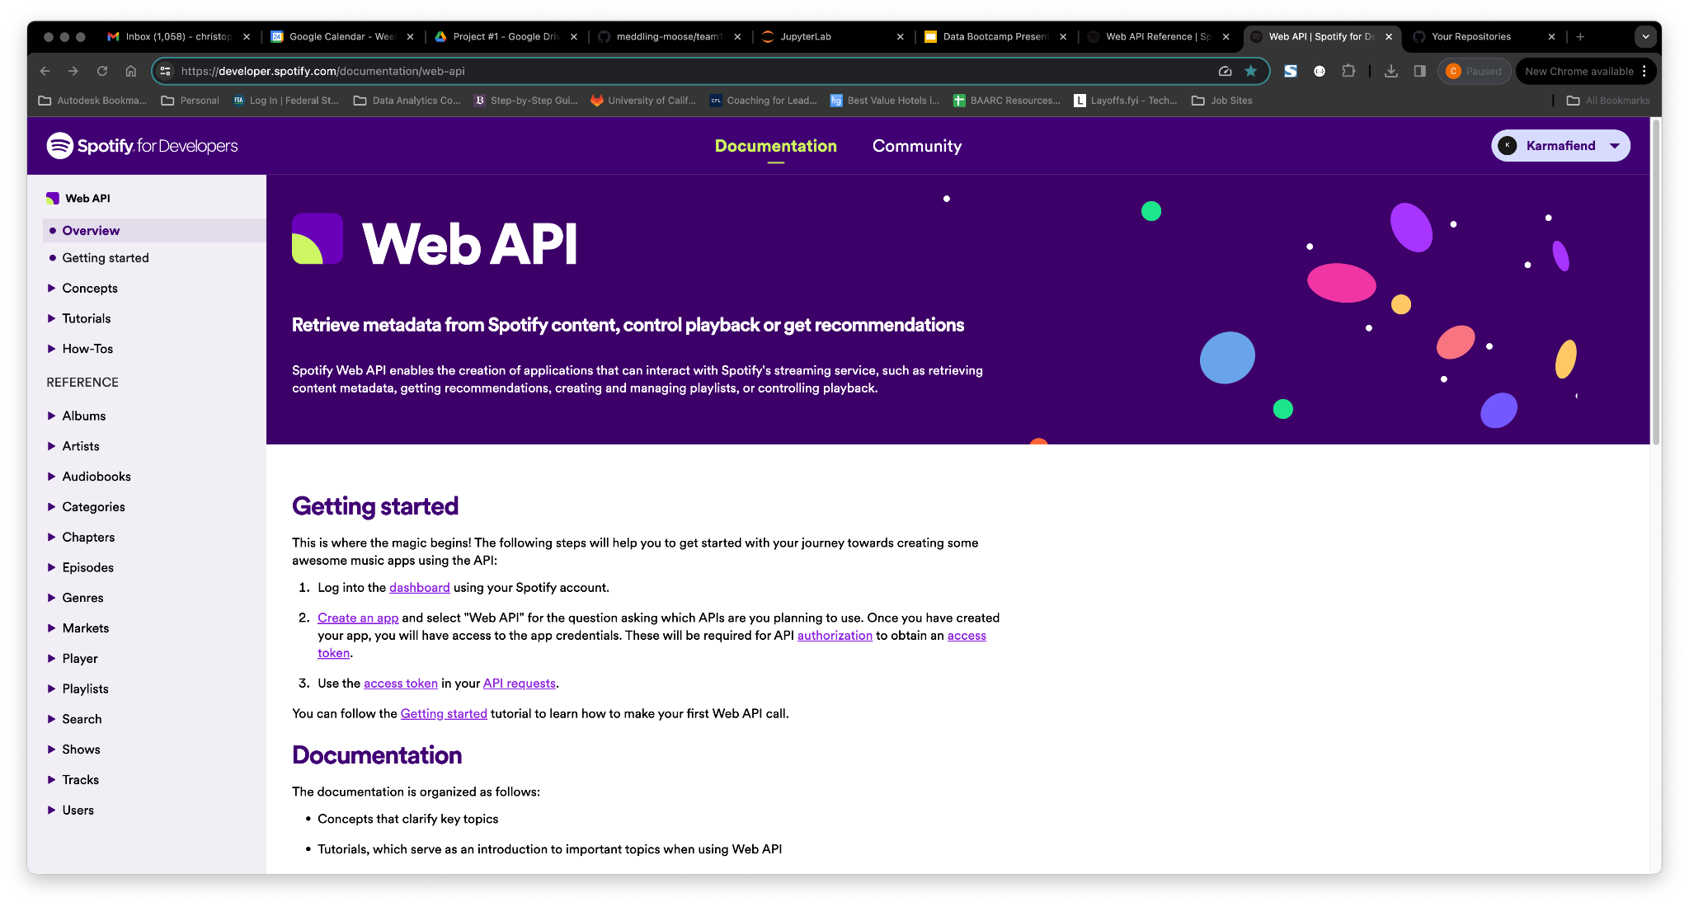
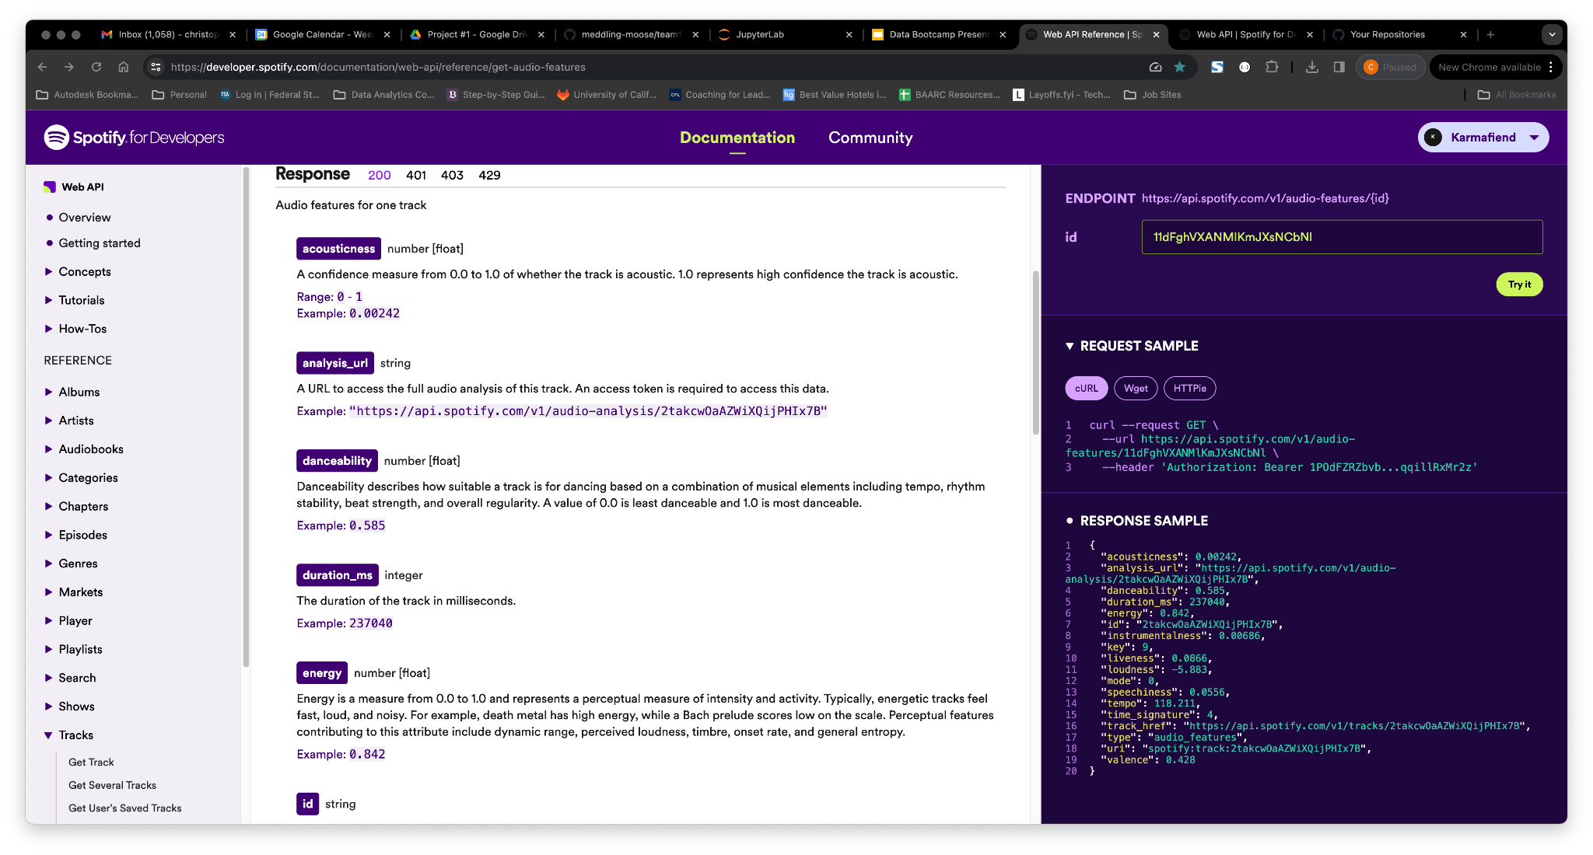
Step 1: Work with the Spotify API
For more information visit the project README file located here: https://developer.spotify.com/documentation/web-api/reference/get-audio-features

Slide 4
Project & Analysis overview
Analysis Goal
Analysis Result: Three types of questions
Examine musical attributes globally
Analyze detailed differences about Spotify user artist & preference (popularity) by country, artist, genre and other criteria
Those we could analyze
Music attributes like “danceability” and “energy”
Those we could not analyze
Song, artist popularity by country, genre, etc. (i.e. our original goal)
Those to analyze further
Global and country attribute min/max, individual artist comparison
Notes:
Questions we wanted to answer:
Are there any statistical significance globally among various music attributes? A: Some, yes.
Can we find the countries of the maximum and minimum values for each audio feature? A. Yes, requires additional statistical analysis.
Could we determine the specific music attributes and variances among them for single artists across countries? A. No, the API did not provide the data to support this analysis.
Is there a way to measure the popularity of music by its attributes by countries and then analyze? A. No, the API did not provide the data to support this analysis.
Are there country variances among music attributes that are meaningful globally? A. Interesting patterns that require additional statistical analysis.
What attributes of an artist’s work are more/less correlated across regions or countries?

Slide 5
Technical Logistics & Challenges Addressed
Logistics :
APIs used: Spotify’s “Web API” (https://developer.spotify.com/documentation/web-api)
Tools used: Pearson R from Scipy.stats library (not taught, but used in Challenge 6)
Technical challenges:
API often did not provide the data in the format, or in its content, to support our analyses (i.e. forced to focus on aggregated music attributes, rather than their popularity by country and artist as we desired.
Spotify token process to access API (not taught)
Installing Spotipy library in order to access Spotify API (not taught)
Modifying Mac/Win shell to store Spotify credentials to anonymize code (not taught)
For more information visit the project README file located here: https://developer.spotify.com/documentation/web-api/reference/get-audio-features
Notes:
Break out into 2 categories: Data challenges - where Spotify’s API couldn’t provide the data we needed to answer questions; and new (to us) things we had to learn to do the analysis.

Slide 6
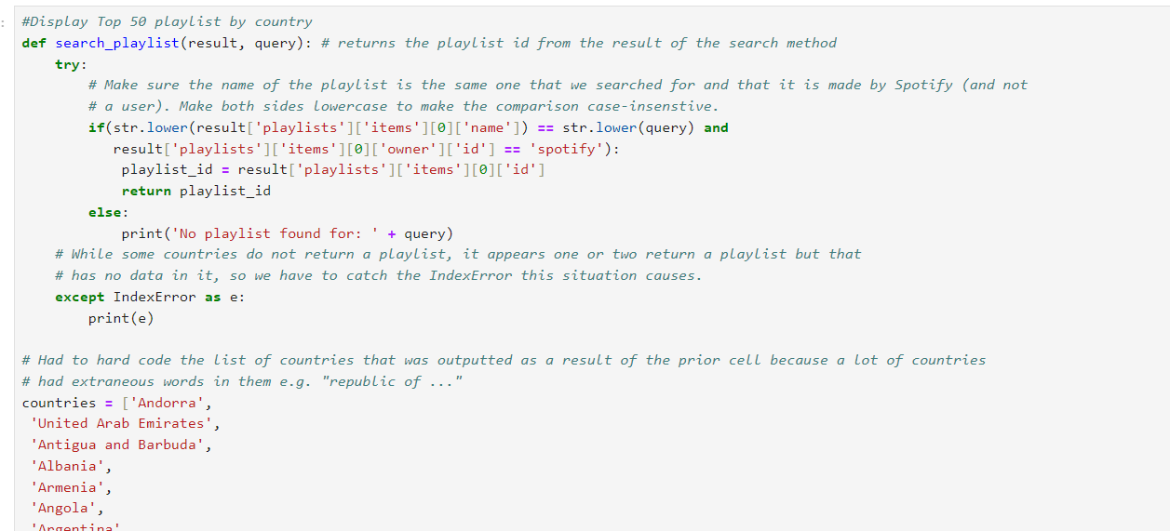
Step 2: Secure a New Source Of Data - Top 50 Playlists
1.
Leveraged existing Spotify code from Github repository to identify the Top 50 Playlists by country in Spotify - required hardcoding countries
Notes:
Data cleansing process:
Step 1: We leveraged the code available online and displayed the top 50 playlist. That code was limiting as it didn’t include all the countries that Spotify api has. Online we found a dictionary….and hard coded the list of countries to this code
Step 2: We used the try except block because some countries did not return a playlist..
Step 3: we passed the search rails to the search list function..created list of tracks from the playlist and saved into csv
Step 4: We exported the data to cab before the first for loops moves to the next country.
Step 5: Merged the country data files into one combines dataframe for analysis

Slide 7
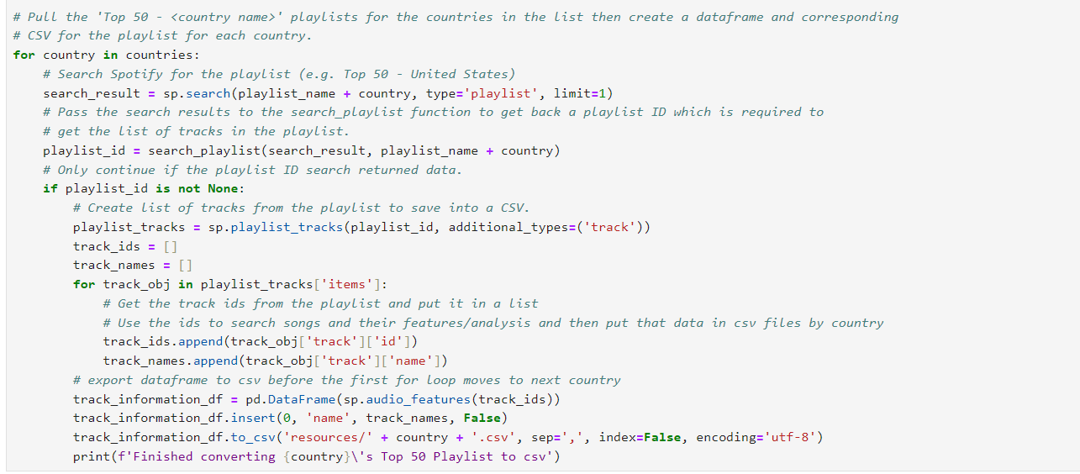
Step 3: Pull data, Assign to Countries
2.
Created list of tracks from the playlists to save into a .CSV file format and then we put that data into separate .csv files by country - this gave us country specific data
Notes:
Data cleansing process:
Step 1: We leveraged the code available online and displayed the top 50 playlist. That code was limiting as it didn’t include all the countries that Spotify api has. Online we found a dictionary….and hard coded the list of countries to this code
Step 2: We used the try except block because some countries did not return a playlist..
Step 3: we passed the search rails to the search list function..created list of tracks from the playlist and saved into csv
Step 4: We exported the data to cab before the first for loops moves to the next country.
Step 5: Merged the country data files into one combines dataframe for analysis

Slide 8
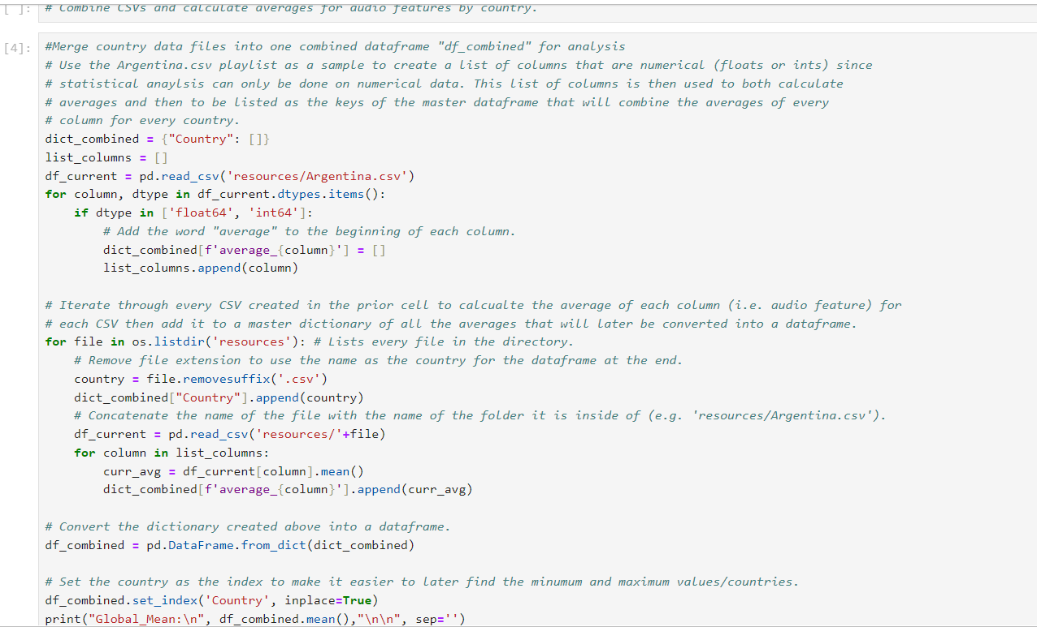
Step 4: Combine Country .CSVs into 1 combined dataframe
3.
Use combined dataframe to then analyze country specific music attributes to determine statistical relationships (correlation, regression) and determine top / lowest minimum and maximum for specific countries
Notes:
Data cleansing process:
Step 1: We leveraged the code available online and displayed the top 50 playlist. That code was limiting as it didn’t include all the countries that Spotify api has. Online we found a dictionary….and hard coded the list of countries to this code
Step 2: We used the try except block because some countries did not return a playlist..
Step 3: we passed the search rails to the search list function..created list of tracks from the playlist and saved into csv
Step 4: We exported the data to cab before the first for loops moves to the next country.
Step 5: Merged the country data files into one combines dataframe for analysis

Slide 9
Spotify Web API Key Music Attribute Definitions
Acousticness | A confidence measure from 0.0 to 1.0 of whether the track is acoustic. 1.0 represents high confidence the track is acoustic.
Danceability | Danceability describes how suitable a track is for dancing based on a combination of musical elements including tempo, rhythm stability, beat strength, and overall regularity. A value of 0.0 is least danceable and 1.0 is most danceable.
Energy | Energy is a measure from 0.0 to 1.0 and represents a perceptual measure of intensity and activity. Typically, energetic tracks feel fast, loud, and noisy. For example, death metal has high energy, while a Bach prelude scores low on the scale.
Instrumentalness | Detects the presence of an audience in the recording. Higher liveness values represent an increased probability that the track was performed live. A value above 0.8 provides strong likelihood that the track is live.
Loudness | The overall loudness of a track in decibels (dB). Loudness values are averaged across the entire track and are useful for comparing relative loudness of tracks. Values typically range between -60 and 0 db.
Speechiness | Speechiness detects the presence of spoken words in a track. The more exclusively speech-like the recording (e.g. talk show, audio book, poetry), the closer to 1.0 the attribute value.
Valence | A measure from 0.0 to 1.0 describing the musical positiveness conveyed by a track. Tracks with high valence sound more positive (e.g. happy, cheerful, euphoric), while tracks with low valence sound more negative (e.g. sad, depressed, angry).
For the complete Web API music attribute definitions visit: https://developer.spotify.com/documentation/web-api/reference/get-audio-features

Slide 10
Global analysis

Slide 11
Global Analysis: Overview
In this first analysis, after discarding our original interest in analyzing user music prefernce by countries and regions, and instead focused on the global music attributes (“danceability,” “valence,” “energy,” etc.) as a whole.
We conducted correlation and regression analyses on a series of music attribute comparison to determine if there were any statistical relationships:
Most statistically significant: “Energy” relatively strongly predicts “Danceability”
Somewhat less strongly, “Loudness” also predicts “Danceability”
Two other comparisons we made - “Loudness” vs. “Acousticness” they were only slightly negatively correlated; and “Speechiness” and “Valence” were only mildly correlated.

Slide 12
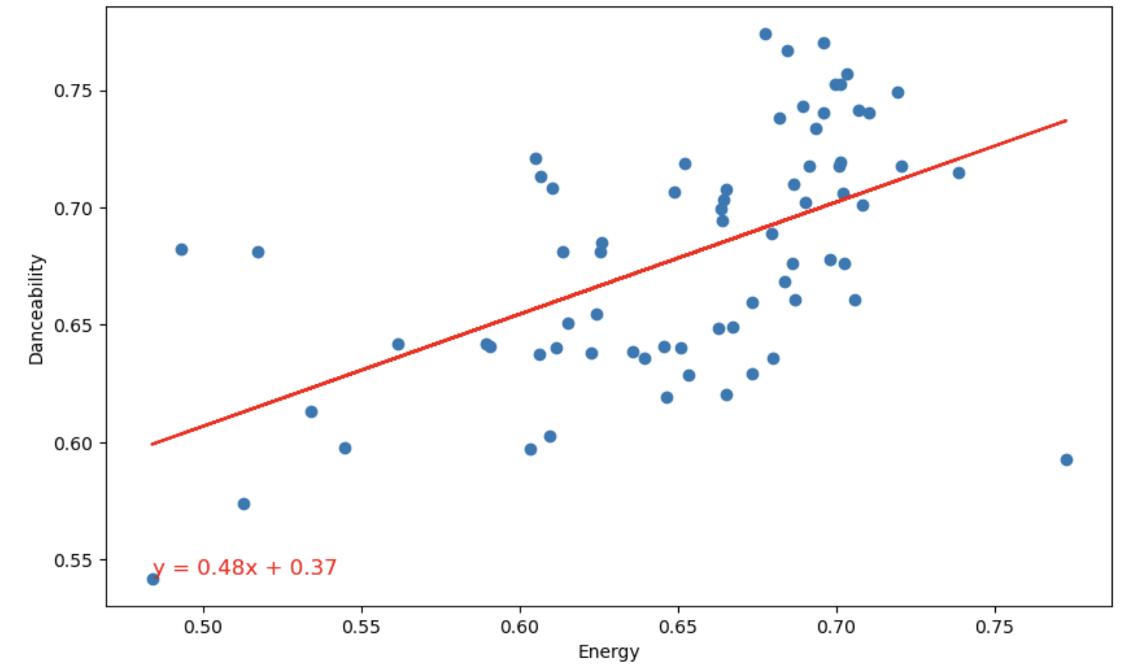
Global Analysis: Energy vs. Danceability
Finding: As energy increases, danceability does too
Correlation: 0.5447
P-value: 0.0000
Regression: y = 0.48x + 0.37
Globally there is a relatively strong, statistically significant relationship, indicating the more energy a song has the more danceable it tends to be too
For the complete Web API music attribute definitions visit: https://developer.spotify.com/documentation/web-api/reference/get-audio-features
Notes:
Analysis background:
Correlation coefficient of 0.5447: A mid-range figure indicating a positive and fairly strong relationship.
P-value effectively at 0 (0.0000): Indicates that relationship isn’t caused by accident or “noise” in the data.
Regress value of y = 048x + 0.37: Signifying that energy is a significant predictor of danceability in the dataset.

Slide 13
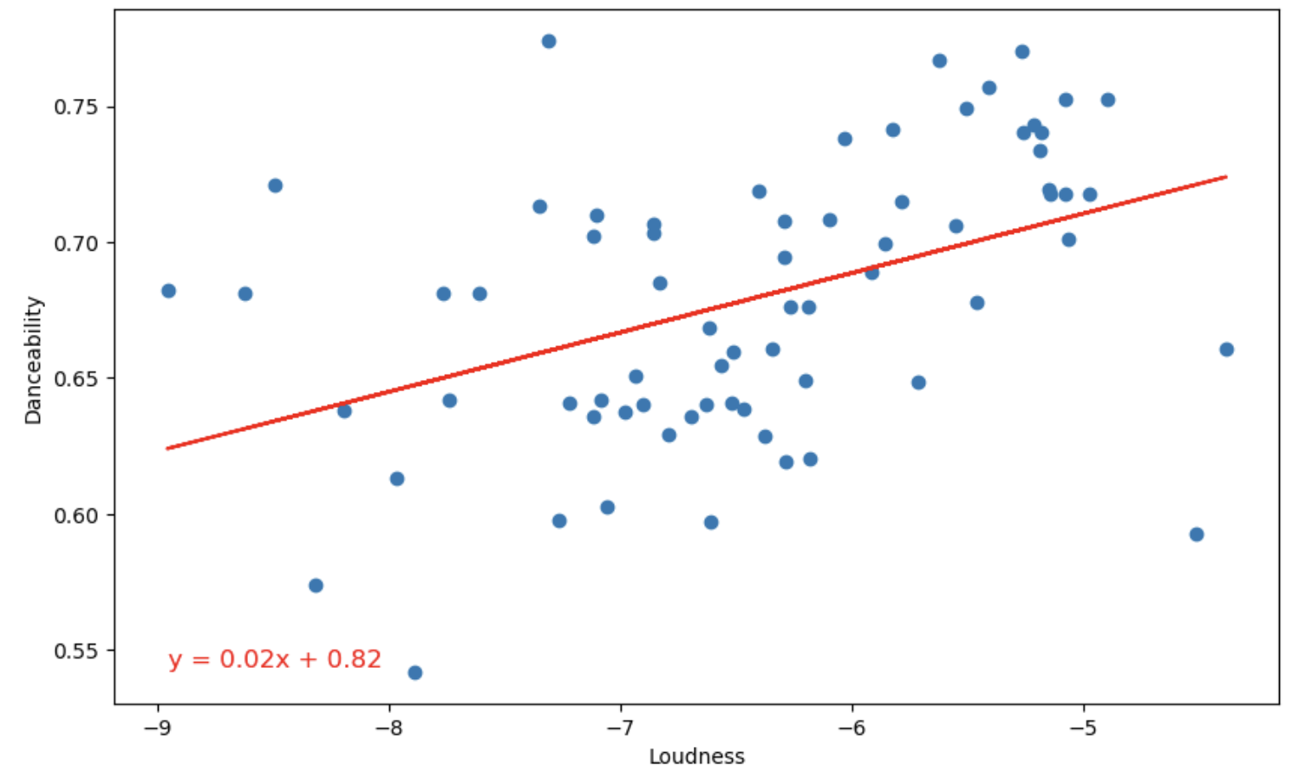
Global Analysis: Loudness vs. Danceability
Finding: Louder music may be slightly more danceable
Correlation: 0.4388
P-value: 0.0001
Regression: y = 0.02x + 0.82
The relationship is relatively weak, though statistically significant, indicating that louder music may generally be more danceable
For the complete Web API music attribute definitions visit: https://developer.spotify.com/documentation/web-api/reference/get-audio-features
Notes:
Analysis background:
Correlation coefficient (r) of 0.4388: This value indicates a moderate positive relationship between loudness and danceability. It suggests that as loudness increases, danceability tends to increase as well, though the relationship is not extremely strong.
P-value of 0.0001: This very low p-value remains indicative of the correlation's statistical significance. It reinforces the likelihood that the observed relationship between loudness and danceability in your dataset is not due to random chance, but rather represents a real association within the population of songs analyzed.
Regression equation (y = 0.02x + 0.82): The regression model suggests that for every unit increase in loudness, danceability increases by 0.02 units, with an intercept of 0.82. This indicates a slight effect of loudness on danceability, quantifying the relationship's direction and magnitude.

Slide 14
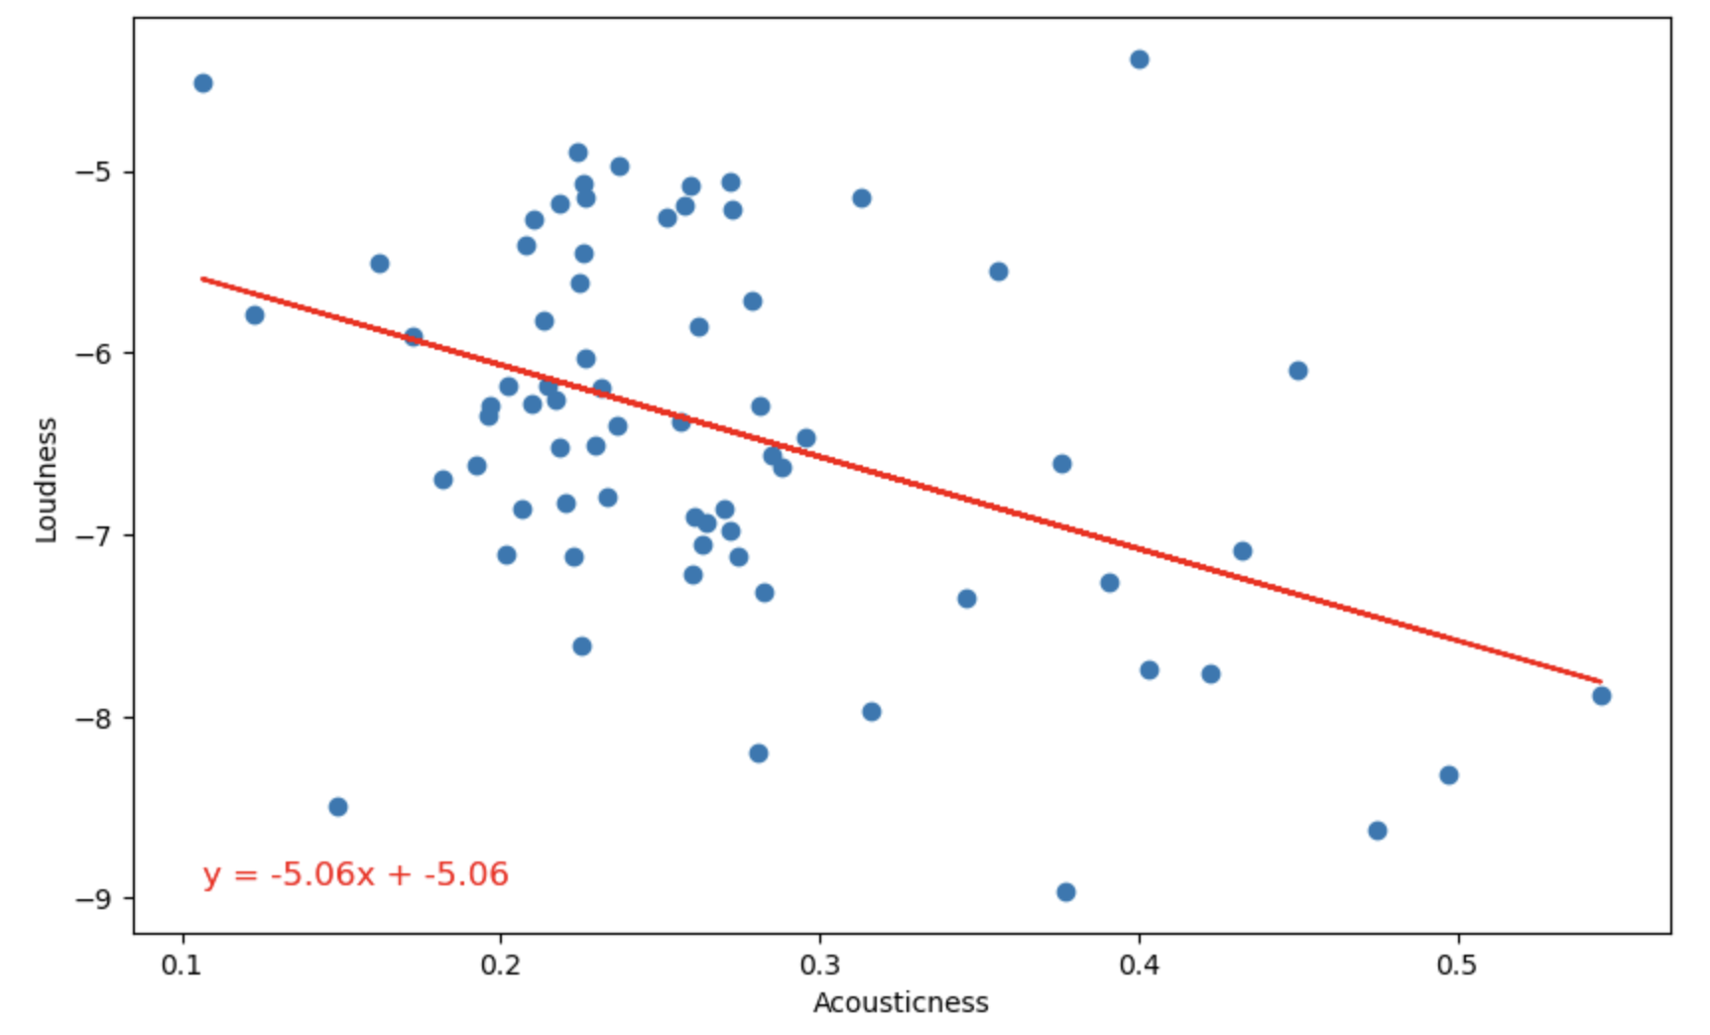
Global Analysis: Loudness vs. Acousticness
Finding: The louder music is the slightly less likely it is to be acoustic
Correlation: -0.4229
P-value: 0.0003
Regression: y = -5.06 + -5.06
While not a strong negative correlation, the analysis indicates that globally acoustic music may tend to be quieter than other forms of music (i.e. “heavy metal”)
For the complete Web API music attribute definitions visit: https://developer.spotify.com/documentation/web-api/reference/get-audio-features
Notes:
Analysis background:
Correlation coefficient (r) of -0.4229: Indicates a moderate negative relationship between loudness and acousticness. As the loudness of a song increases, its acousticness tends to decrease.
P-value of 0.0003: This indicates this relationship is statistically significant.
Regression equation (y = -5.06x + -5.06): The slope of -5.06 indicates a substantial negative effect of loudness on acousticness; for every unit increase in loudness, acousticness decreases by 5.06 units. This suggests a strong impact of loudness on the acoustic nature of a song.

Slide 15
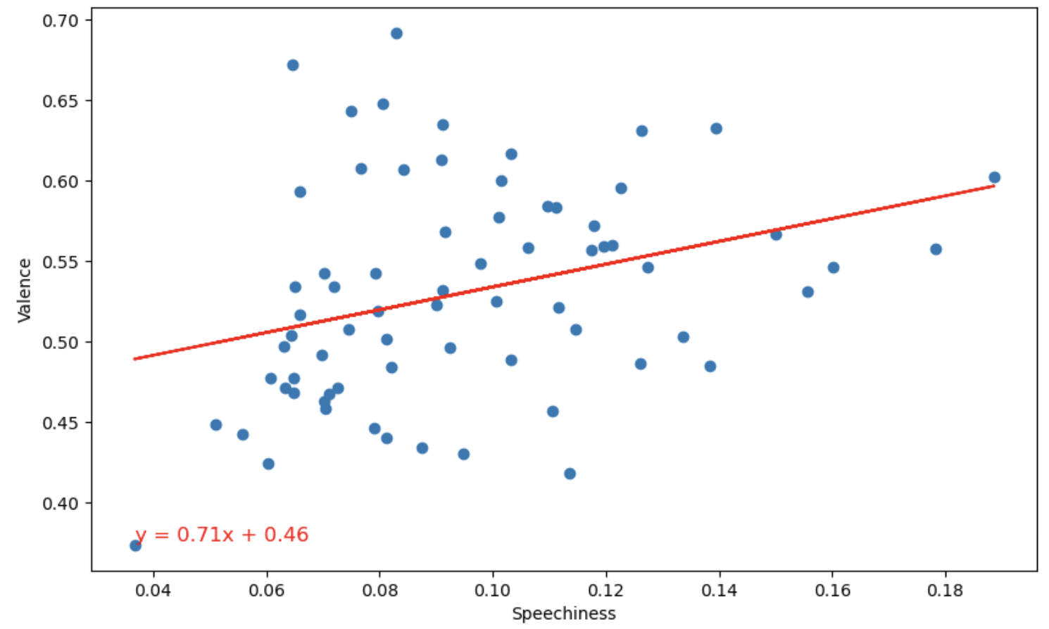
Global Analysis: Speechiness vs. Valence
Finding: The relationship between spoken word vs. positive “feeling” is moderate but statistically significant
Correlation: 0.3211
P-value: 0.0067
Regression: y = 0.71x + 0.46
In theory this means that songs with more spoken word content may tend to bemore positive (i.e. “valence”)
For the complete Web API music attribute definitions visit: https://developer.spotify.com/documentation/web-api/reference/get-audio-features
Notes:
Analysis background:
Correlation coefficient (r) of 0.3211: There is a weak to moderate positive relationship between speechiness and valence. While not extremely strong, there is a tendency for songs with higher levels of spoken words (speechiness) to be perceived as having a more positive mood (valence).
P-value of 0.0067: This p-value is below the common threshold of 0.05 for statistical significance, thereby the observed correlation is unlikely to have occurred by chance.
Regression equation (y = 0.71x + 0.46): The slope of 0.71 indicates a relatively strong positive effect of speechiness on valence, meaning that for every unit increase in speechiness, valence is predicted to increase by 0.71 units.

Slide 16
Regional analysis

Slide 17
Regional Analysis
In this section we grouped the available countries by geographic and cultural aggregate data and analyzed it on the features mentioned above
We were hoping to learn whether different regions in the world had preferences by way of key features like: danceability, loudness, speechiness, valence, and duration
Liberties taken while grouping:
Spotify lacks many countries top 50 playlists, inc: China, Russia, Jamaica, most African countries
Some regions were grouped with other sparse regions: ‘English Speaking’ and South Asia
Important to note that the playlists updated daily and are subject to decision by spotify’s algorithms
Notes:
South Asia includes: India, Pakistan, and Kazakhstan
Middle east is comprised only of Egypt, Israel, Turkey, and Saudi Arabia
Saudi Arabia is such an outlier in every category, that looking at middle eastern averages, is just seeing a slightly skewed Saudi Arabian average

Slide 18
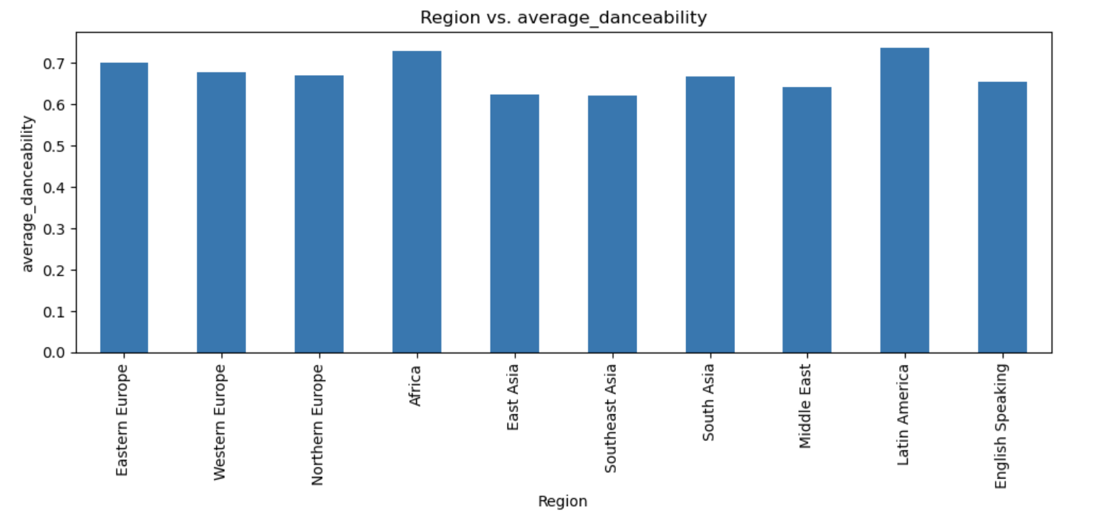
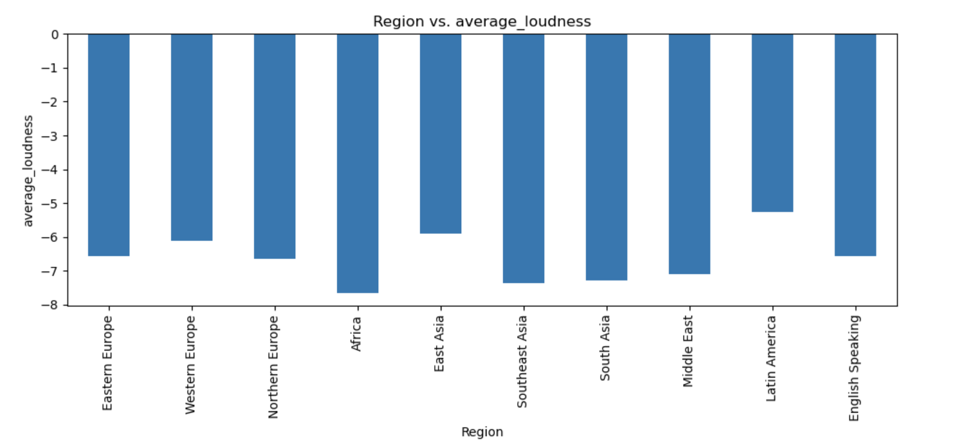
Regional Analysis
Africa and Latin America
Western, Northern, and Eastern Europe
South, Southeast, and East Asia
Middle East and Central Asia
Notes:
Closer to zero is louder

Slide 19
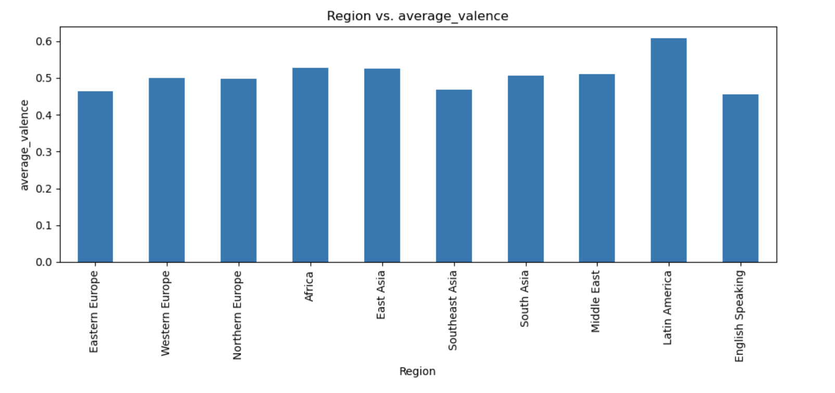
Regional Analysis
English Speaking Countries
Below average danceability
Above average loudness
Below average speechiness
Lowest average valence
Above average in duration
Below average instrumentalness
If these attributes are any of the reasons why you like english music, perhaps there is other music out there that better embodies why you enjoy listening, go explore!
Notes:
The english speaking countries are: USA, United Kingdom, Australia, and New Zealand
I am doing this alone because of the longitudinal diversity and because alone it is quite interesting

Slide 20
Analysis questions requiring further investigation (and time)

Slide 21
Area of Exploration: Artist Comparison to Global Means
Comparison of “Cruel Summer” to global means:
Energy = 0.702, below max country average of 0.772
Key = 9, higher than max country average value of 6.86
Mode = 1, higher than max country average value of 0.9
Tempo = 169, higher than max country average value of 138.41
Time signature = 4, below max country average value of 4.08
Average liveness = 0.105, below the country average min of 0.125
Analysis Implication:
Future statistical analysis suggested on whether specific music attributes influence a song’s popularity.
Taylor Swift
“Cruel Summer”
“Cruel Summer’s” Spotify music attributes:
Danceability: 0.552
Energy: 0.702
Key: 9
Loudness: 5.707
Mode: 1
Speechiness: 0.157
Acousticness: 0.117
Instrumentalness: 0.000021
Liveness: 0.105
Valence: 0.564
Tempo: 169.994
Duration_ms: 178427
Time_signature: 4

Slide 22
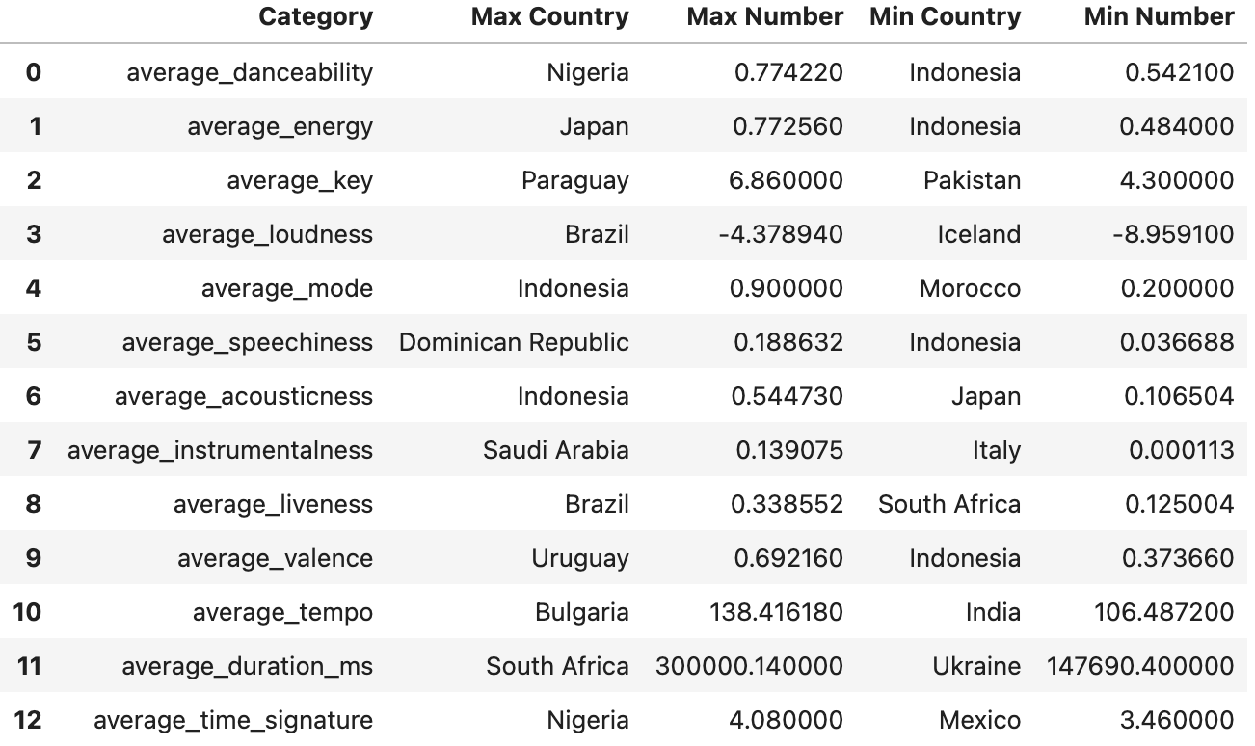
Area of Exploration: Global Min and Max comparisons
Potential analysis:
Statistical comparison of individual country min / max
Analysis purpose:
With additional contextual data (popularity, user demographics / psychographics) could use to determine if music and songs should be tailored to country music attribute preference
Notes:
Closer to zero is louder

Slide 23
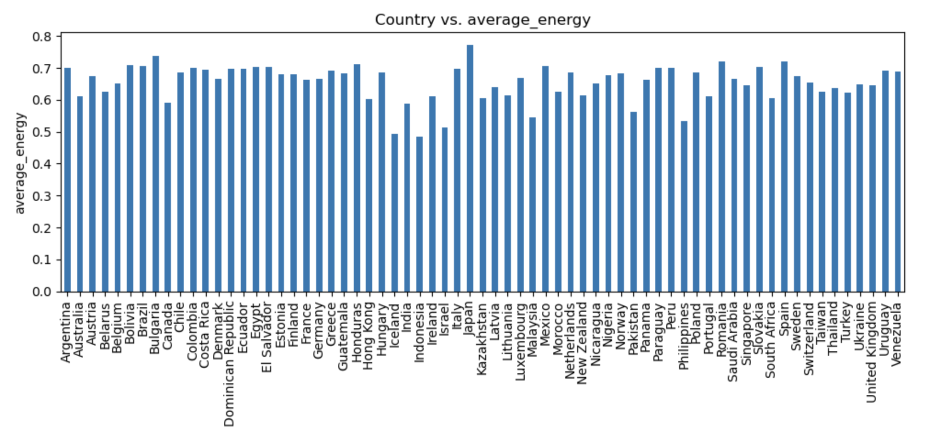
Area of Exploration: Country variance comparison
Potential analysis:
Statistical comparison of individual country music attributes
Analysis purpose:
Could use to determine if music and songs should be tailored to country specific music attributes

Slide 24
Thank you!

Slide 25
Appendix

Slide 26
Regional analysis

Slide 27
Regional Analysis
Africa and Latin America had the most dancy music on average but…
Africa has the quietest and Latin America has the loudest average music
Both are relatively speechy, Africa is the most
Both are relatively high in valence (happy, euphoric), Latin America is the most
Africa has the longest songs of any region on average, Latin America is amongst the shortest average song regions
Africa was among the most instrumental, Latin America was the least

Slide 28
Regional Analysis
East Asia, Southeast Asia, and South Asia
East, Southeast, and South Asia were among the least dancy regions, South Asia is about at world average danciness
East Asia is the second quietest, Southeast and South Asia are louder than average
East and Southeast Asia are the least speechy and South Asia is more speechy than average
All three had an average duration that was longer than the world average
East and Southeast Asia had the 2nd and 3rd least instrumental songs on average, while South Asia had the most instrumental songs

Slide 29
Regional Analysis
Eastern Europe, Western Europe, and Northern Europe
All three were at or above world average danciness
All three were at or above world average speechiness, but Eastern Europe was the 2nd most speechy
All three were at or below world average valence, but Eastern Europe was the 2nd least valent(?) region in the world
Together, these regions comprised the three shortest average duration regions
Western and Northern Europe were average instrumentally, but Eastern Europe was one of the most instrumental (3rd)

Slide 30
Regional Analysis

Slide 31
Regional Analysis
Notes:
Closer to zero is louder

Slide 32
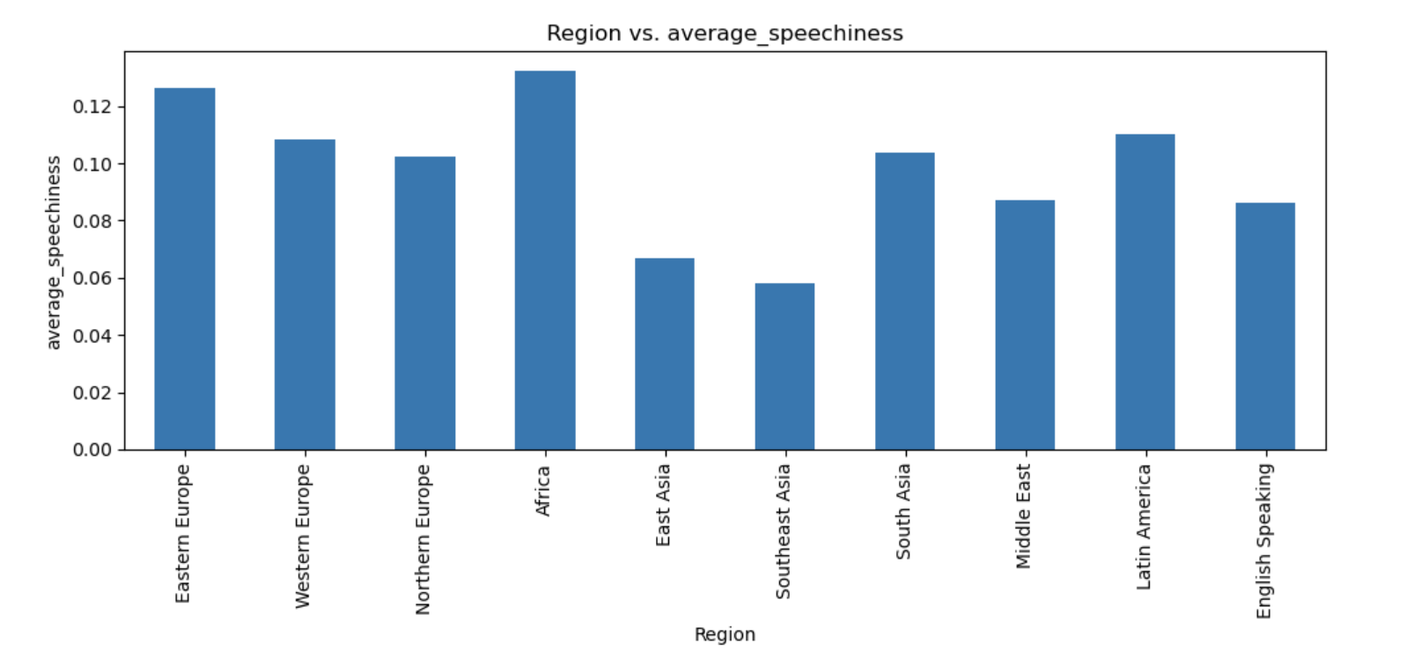
Regional Analysis

Slide 33
Regional Analysis

Slide 34
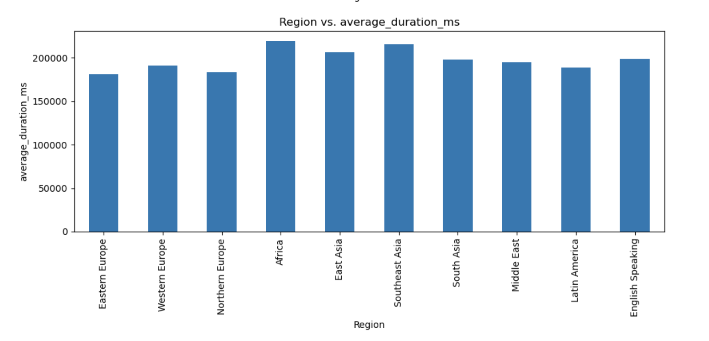
Regional Analysis

Slide 35
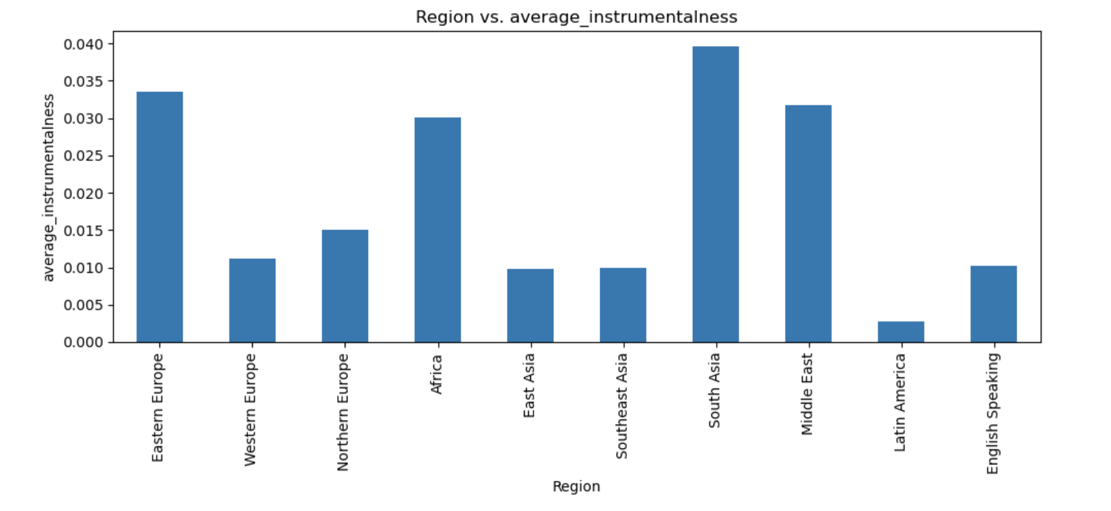
Regional Analysis

Slide 36
Country analysis

Slide 37
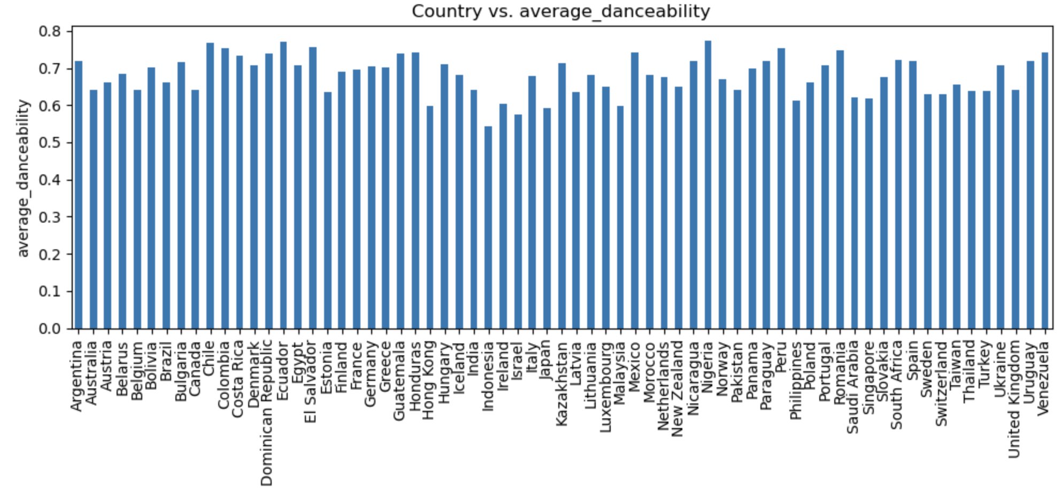
Analysis: Country music attribute - danceability

Slide 38
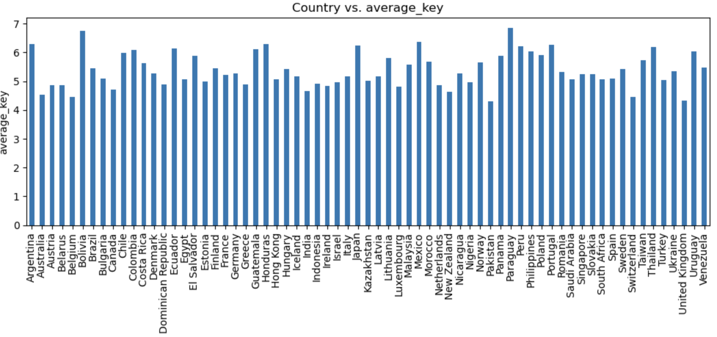
Analysis: Country music attribute - key

Slide 39
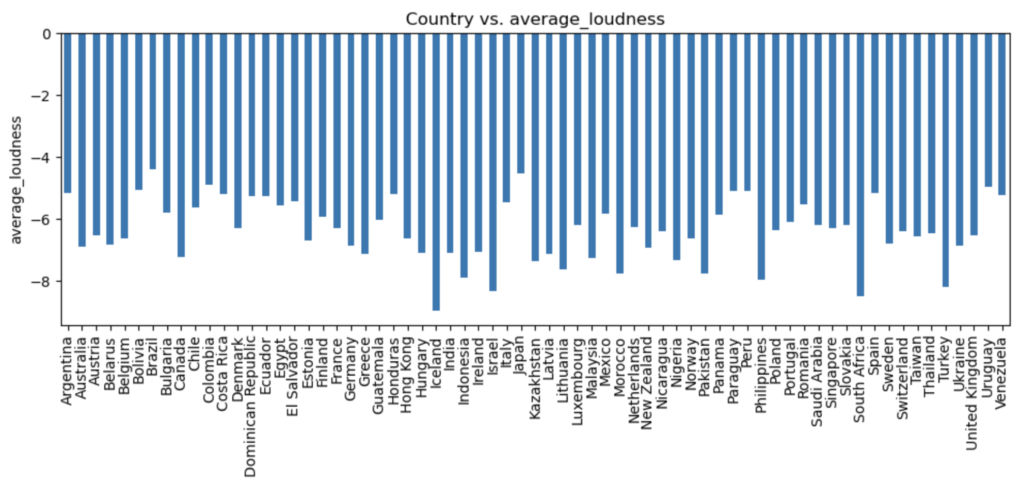
Analysis: Country music attribute - loudness

Slide 40
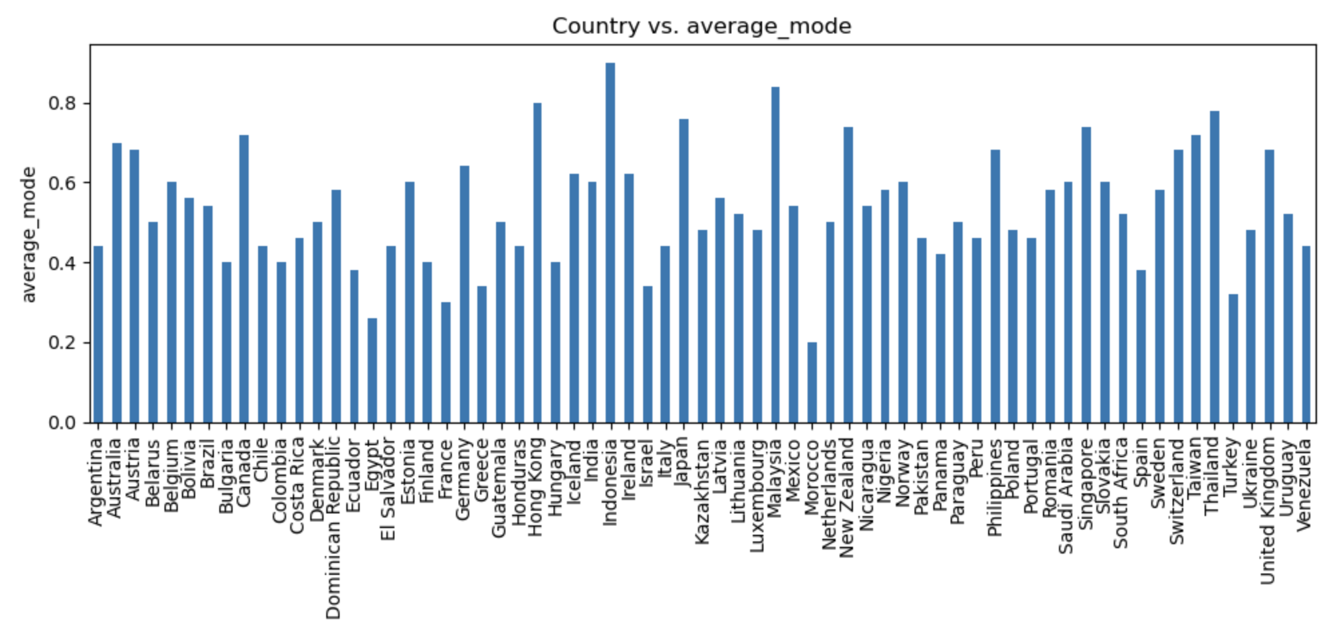
Analysis: Country music attribute - mode
Mode: “Mode indicates the modality (major or minor) of a track, the type of scale from which its melodic content is derived. Major is represented by 1 and minor is 0. https://developer.spotify.com/documentation/web-api/reference/get-audio-features

Slide 41
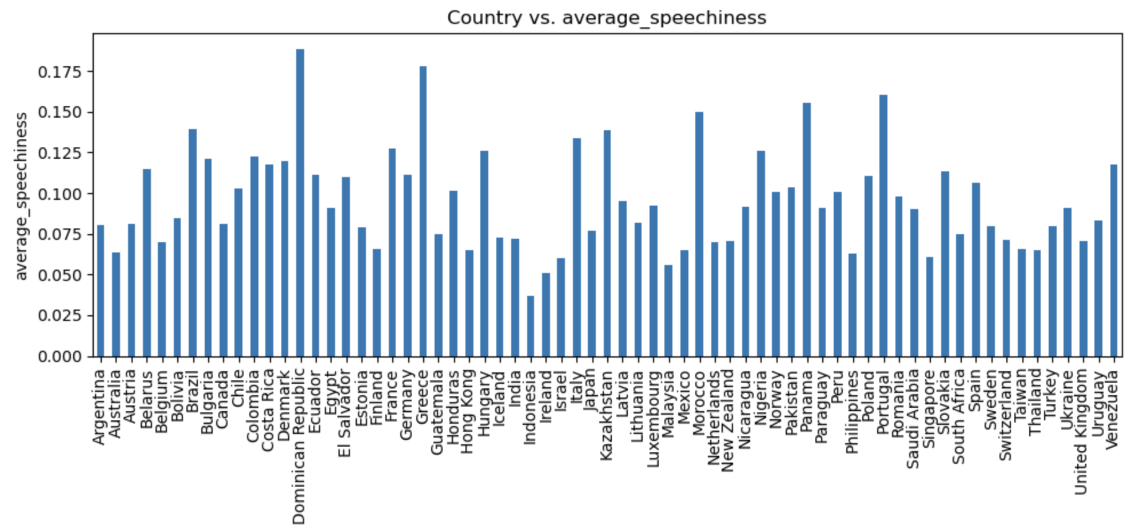
Analysis: Country music attribute - speechiness

Slide 42
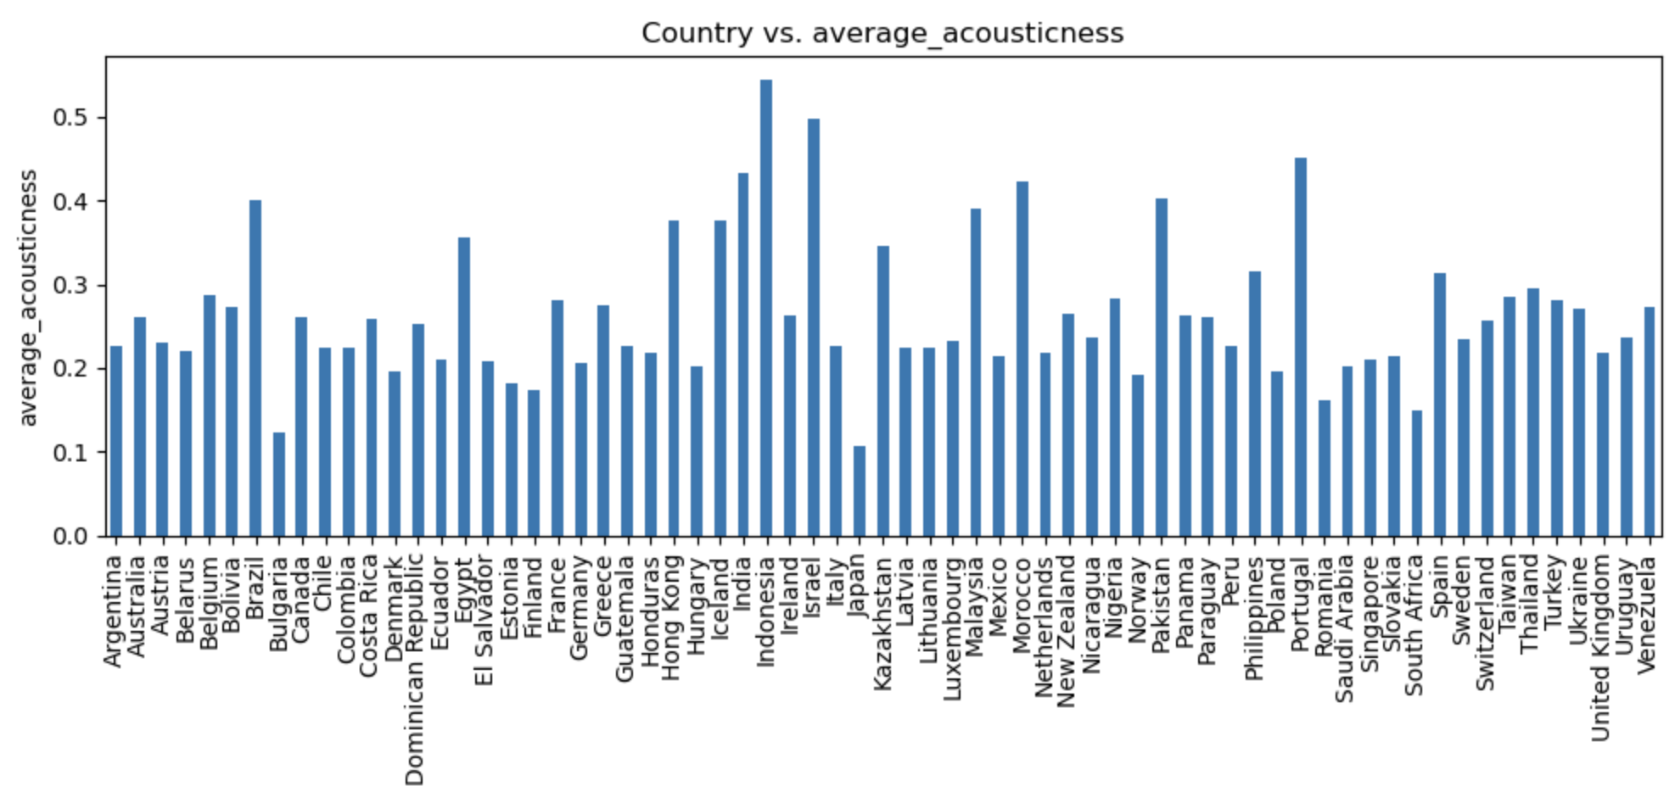
Analysis: Country music attribute - acousticness

Slide 43
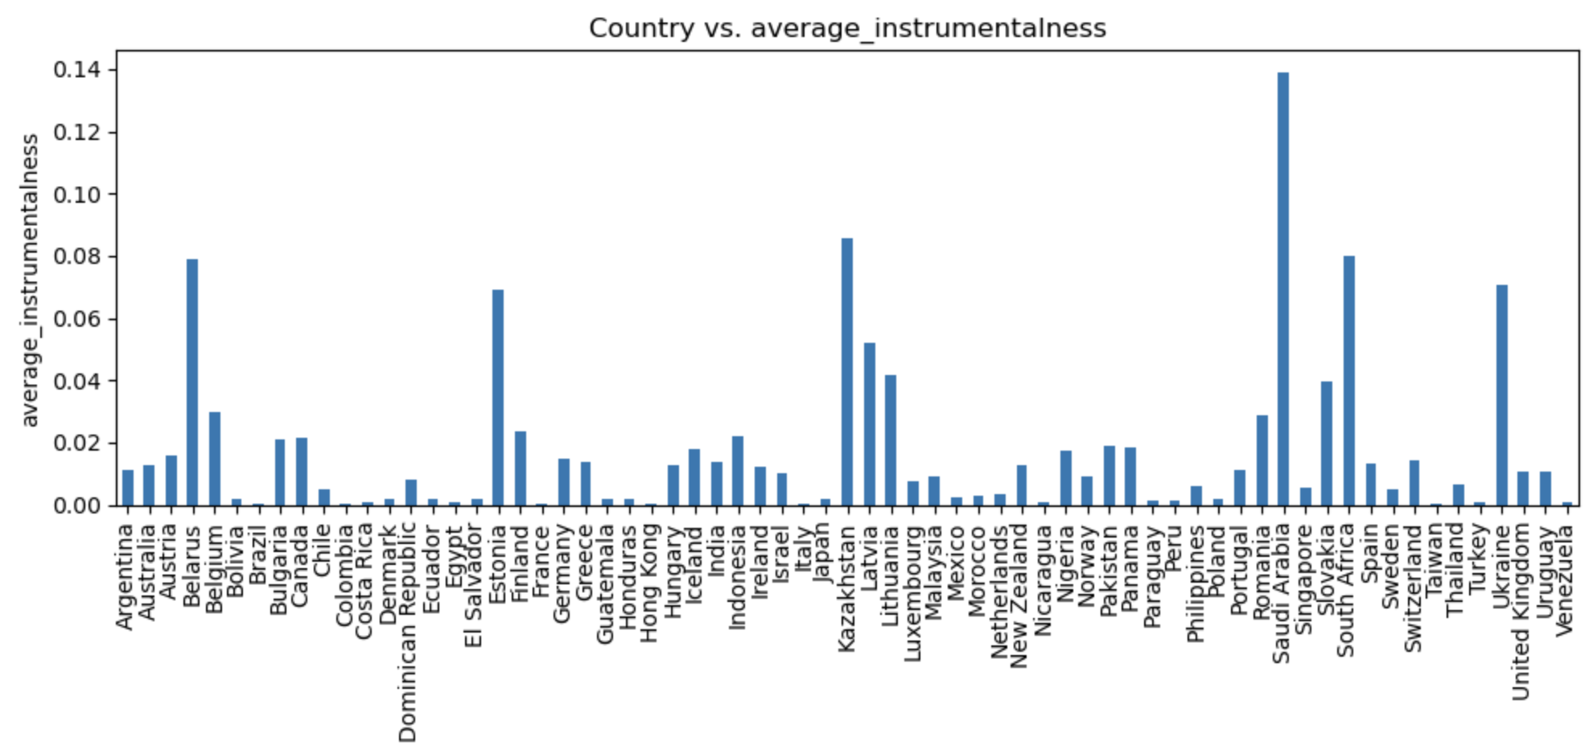
Analysis: Country music attribute - instrumentalness

Slide 44
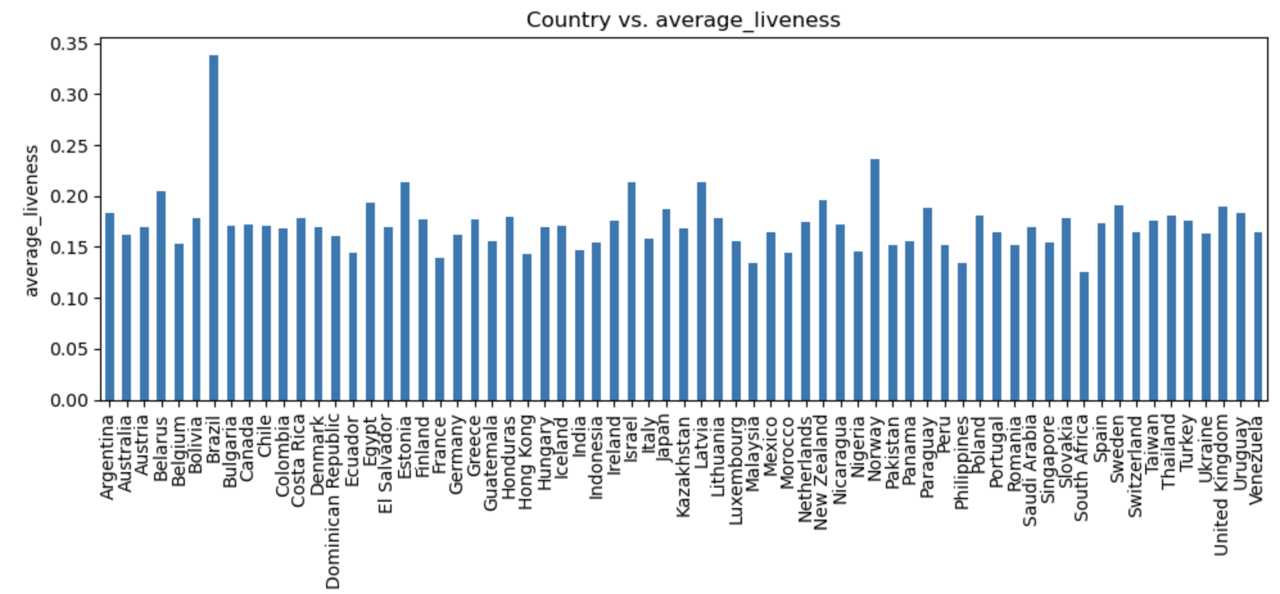
Analysis: Country music attribute - liveness

Slide 45
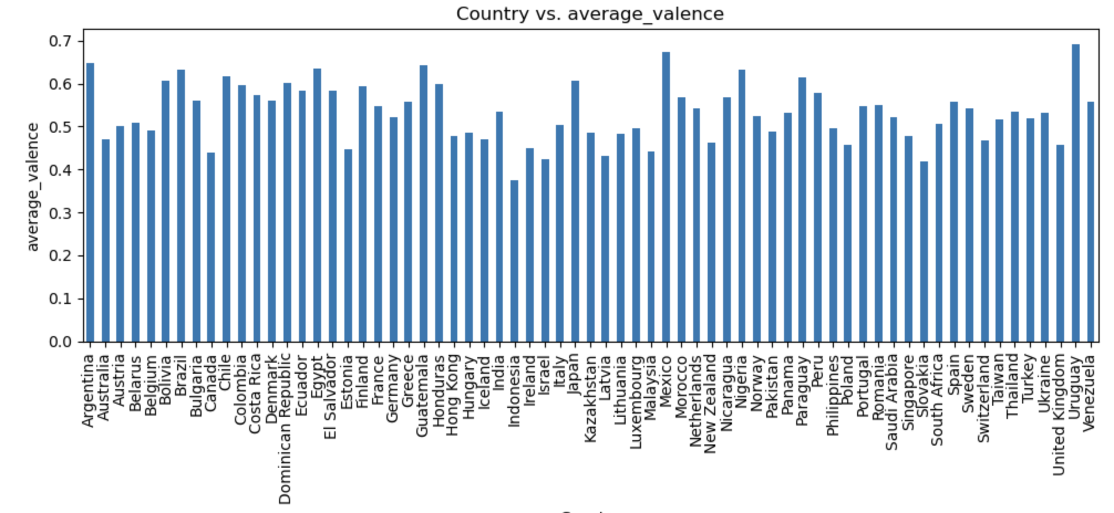
Analysis: Country music attribute - valence

Slide 46
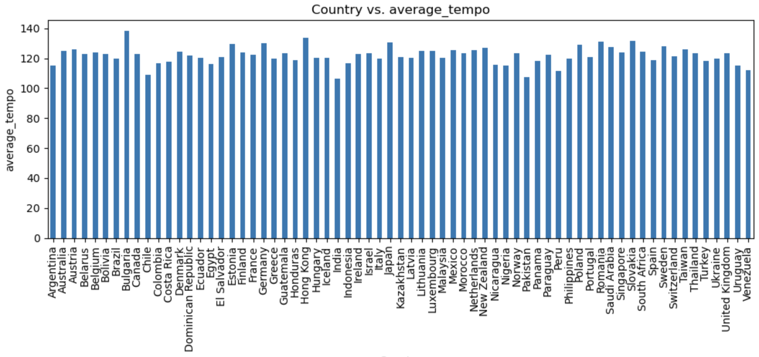
Analysis: Country music attribute - tempo

Slide 47
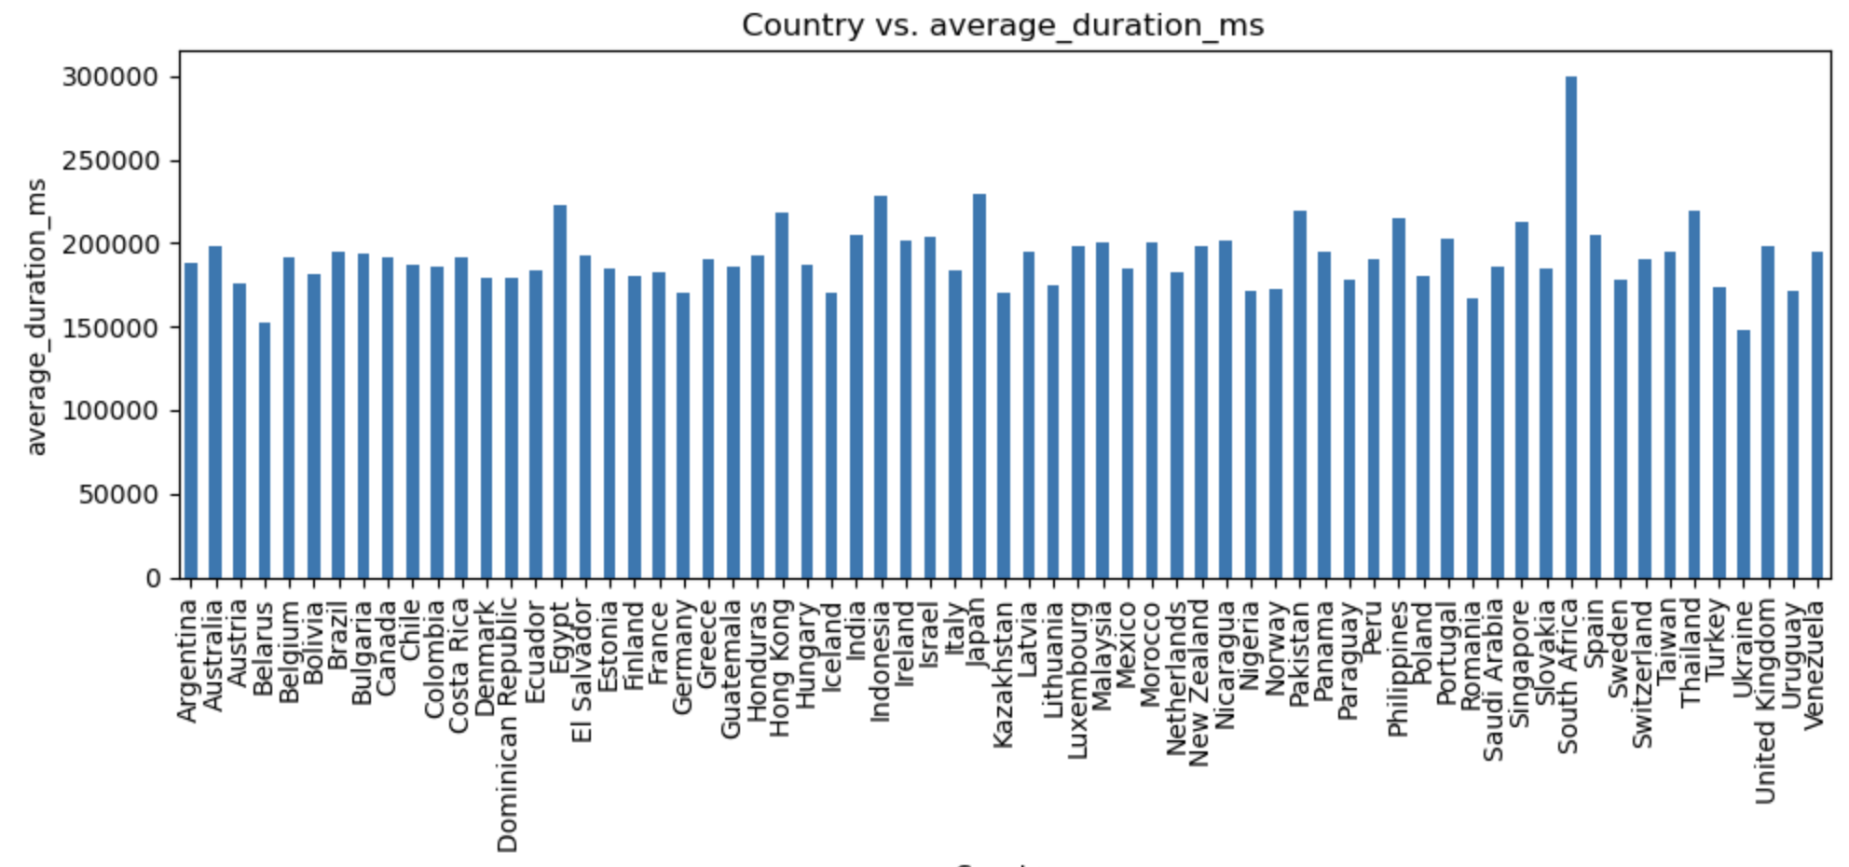
Analysis: Country music attribute - duration (ms)

Slide 48
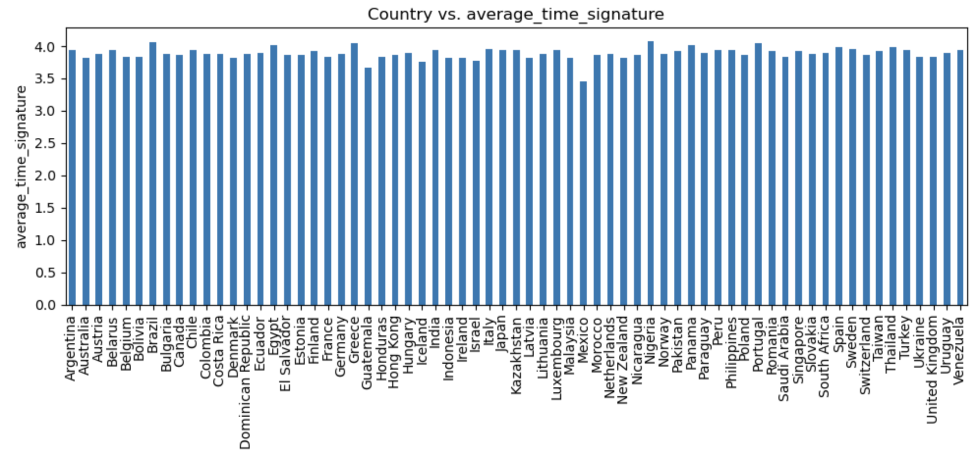
Analysis: Country music attribute - time signature

